Slide 1
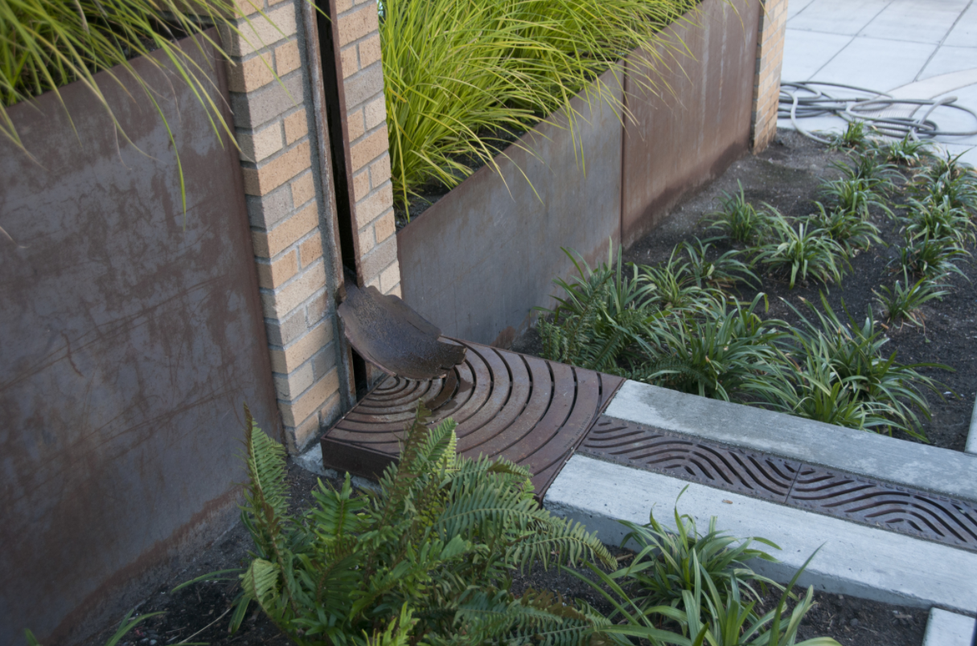
User Case Stories
We’d like to hear how you are using the Stormwater Heatmap.
Submit your story and a photo through the link below.
[ link sends email to: courtney.baxter@tnc.org]
We created this resource because we believe the democratization of data helps innovators to thrive. While TNC retains the sole rights to publish our original work, the datasets are open source so that NPDES permittees, businesses, communities and innovators can help accelerate stormwater solutions.

